Slide 1
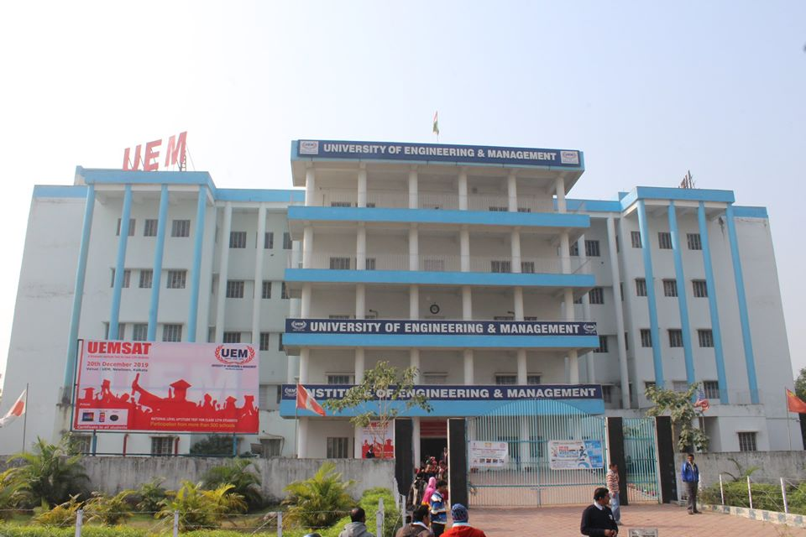


UNIVERSITY OF ENGINEERING & MANAGEMENT
UNIVERSITY OF ENGINEERING AND MANAGEMENT
NABANITA CHAKRABORTY
GS DEPARTMENT
UEM,KOLKATA

Slide 2
VOICES
ACTIVE AND PASSIVE

Slide 3
Voices of Verb
ACTIVE VOICE
PASSIVE VOICE
When the Subject of the sentence is the doer.
When the subject is not the doer but received the action.
Ex: He has written a letter.
A letter has been written by him.

Slide 4
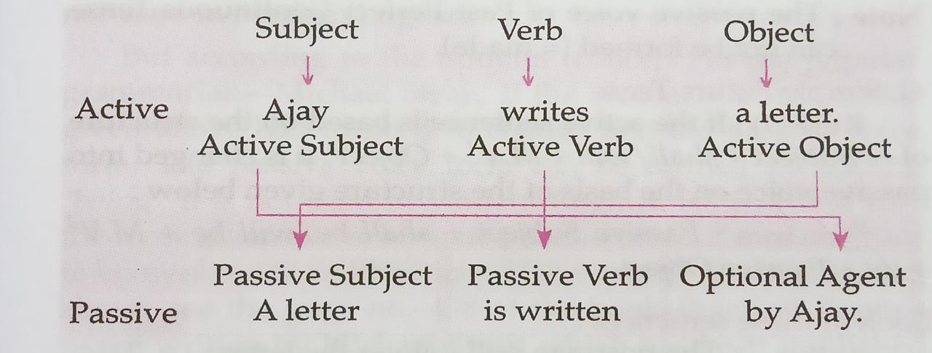

Slide 5
Rules for changing the Active Voice into Passive Voice :
Step (1): Write the object of Active Voice in place of 'subject' in Passive Voice.
Step (2): Use the Auxiliary Verb according to the number, person and tense of the passive subject.
Step (3): Write the past participle form of the Main Verb or use the third form of Main Verb (M.V»).
Step (4): Use the by-preposition.
Note: The by-preposition can be used or can not be used according to need. The other prepositions- at, to, with...etc can be used besides the by-preposition according to need.
Step (5) Write the subject of Active Voice in place of 'object' in passive voice.

Slide 6
Note: The words- one, someone, nobody, people, somebody, no one, police, public, us, them etc are not used as passive objects in Passive Voice.
Active : We should love our country.
Passive : Our country should be loved.
Active : Nobody could kill the criminal
Passive : The criminal could not be killed
Active: Subject + Verb + Object
Passive : Subject +Auxiliary Verb + M.V3 + by + Object

Slide 7
From Active Voice To Passive Voice

Slide 8
A. Simple Present Tense
If the active sentence is based on the structure of-
'Subject +M.V/M.Vs + Object', it is changed into Passive Voice on the basis of the structure given below:
Structure : Passive Subject + is/are/am + M. V3 + by + Passive Object
Look at these sentences :
Active : Children like sweets.
Passive : Sweets are liked by children.
Active : Boys love animals.
Passive : Animals are loved by boys.

Slide 9
B. Present Continuous Tense
If the active sentence is based on the structure of-
'Subject + is/are/am + M.V4 (M.V1 + ing) + Object', it is changed into Passive Voice on the basis of the structure given below :
Structure: Passive Subject + is/are/am + being +M.Vs + by + Passive Object
Look at these sentences :
Active : He is writing a letter.
Passive : A letter is being written by him.
Active : Bhavna is singing a song.
Passive : A song is being sung by Bhavna.
Active: The students are watching the match.
Passive : The match is being watched by the students.

Slide 10
C. Present Perfect Tense
If the active sentence is based on the structure of-
'Subject + has/have + M.V + Object", it is changed into Passive Voice on the basis of the structure given below:
Structure : Passive Subject + has/have + been +MVP+ by + Passive Object
Look at these sentences :
Active : Nutan has written this letter.
Passive : This letter has been written by Nutan.
Active : He has washed the plates.
Passive : The plates have been washed by him.
Active : Someone has stolen my watch.
Passive : My watch has been stolen.

Slide 11
D. Simple Past Tense
If the active sentence is based on the structure of-
'Subject +M.V2 + Object', it is changed into passive voice on the basis of the structure given below:
Structure : Passive Subject + was/were + M.V + by + Passive Object
Look at these sentence:
Active : He stole my book.
Passive : My book was stolen by him.
Active : Ajay spoke the truth.
Passive : The truth was spoken by Ajay.
Active : The mad dog bit the beggar.
Passive : The beggar was bitten by the mad dog.

Slide 12
E. Past Continuous Tense
If the active sentence is based on the structure of-
'Subject + was/were + M.V* (= M.V + ing) + Object, it is changed into passive voice on the basis of the structure given below:
Structure : Passive Subject + was/were + being + M.V3 + by + Passive Object
Look at these sentences :
Active: The farmers were sowing the seeds.
Passive : The seeds were being sown by the farmers.
Active : The gardener was watering the plants.
Passive : The plants were being watered by the gardener

Slide 13
F. Past Perfect Tense
If the active sentence is based on the structure of-
'Subject + had +M.V+ Object', it is changed into passive voice on the basis of the structure given below:
Structure : Passive Subject + had been + M.V3 + by + Passive Object
Look at these sentences :
Active : He had written a letter.
Passive : A letter had been written by him.
Active : They had not done their homework.
Passive : Their homework had not been done.
Active : The players had won the match.
Passive : The match had been won by the players.

Slide 14
G. Simple Future Tense
If the active sentence is based on the structure of-
'Subject + shall/will + MV + Object', it is changed into passive voice on the basis of the structure given below:
Structure : Passive Subject + shall be will be + M.V. + by + Passive Object
Look at these sentences :
Active : The postman will deliver the letters.
Passive : The letters will be delivered by the postman.
Active : People will remember Mother Teresa.
Passive : Mother Teresa will be remembered.

Slide 15
H. Future Perfect Tense
If the active sentence is based on the structure of
'Subject + Shall have/Will have + MV + Object', it is changed into passive voice on the basis of the structure given below:
Structure : Passive Subject + shall/will + have been + M.V. + by + Passive Object
Look at these sentences :
Active : The police will have caught the terrorist.
Passive : The terrorist will have been caught by the police.
Active : The chemist will have closed the shop by ten o'clock.
Passive : The shop will have been closed by the chemist by ten o'clock.

Slide 16
Special Knowledgeable Facts:
Generally The Passive Voice forms of Present Perfect Continuous Tense, Past Perfect Continuous Tense, Future Continuous Tense and Future Perfect Continuous Tense are not used in Modern English.
Present Perfect Continuous Tense
Active : He has been writing a letter for an hour.
Passive : A letter has been being written by him for an hour.
Active: The girls have been learning music for several months.
Passive : Music has been being learnt by the girls for several months.

Slide 17
2. Past Perfect Continuous Tense
Active : Mr. Thakur had been writing this book for six months.
Passive : This book had been being written by Mr. Thakur for six
months.
3. Future Continuous Tense
Active: The boys will be playing hockey.
Passive : Hockey will be being played by the boys.
4. Future Perfect Continuous Tense
Active : They will have been making the toys for two years.
Passive : The toys will have been being made for two years

Slide 18
THANK YOU

